Slide 1
Unit Testing with jest

Slide 2
What will we discuss today?
What is unit testing?
How to improve testability of code
Unit testing with jest
TDD and BDD

Slide 3
What is unit testing?
A “Unit” is a smallest piece of code
“Unit Testing” is validating each unit of the software to ensure it performs as expected.
Q/A
Is unit testing a form of White Box or Black Box testing?

Slide 4
Benefits of Unit Testing
Peace of mind
Covers Edge cases
Efficiency of QA cycles
Documentation (Code speaks louder than comments)
Prompts Better Design
Q/A
Any Other benefits?

Slide 5
How to improve testability of code?
The ease of writing tests is the testability of code
Code should be modular
A unit of code should serve singular purpose
Loose Coupling (Dependency Injection)
TDD
Q/A
Improvement for extractors?

Slide 6
Unit Testing with Jest
Getting started (math module example)
Matchers, Setup Teardowns, Scopes

Slide 7
Mocking with Jest
View Example
https://jestjs.io/docs/mock-function-api
The Jest Object
https://jestjs.io/docs/jest-object

Slide 8

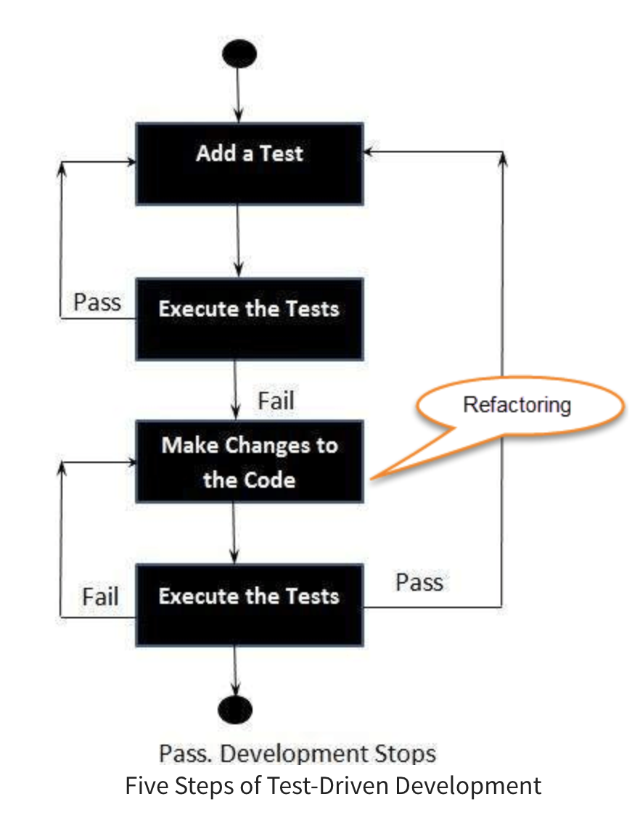
TDD with jest
TDD or Test Driven Development is a software development practice wherein testcases are written even before the code.
This helps drive the design
Improves testability and test coverage
Inherently makes applications loosely coupled
Q/A
Drawbacks of this approach?

Slide 9
BDD or Behavior Driven development
Lines between TDD and BDD are not clear. We might be doing BDD without even knowing it.
BDD means writing tests in a language that is meaningful to everybody in the org and not just the developers.
Cucumber.js is a very popular framework for BDD

Slide 10
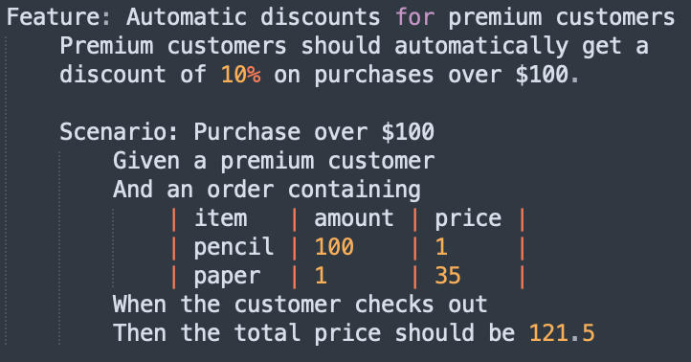
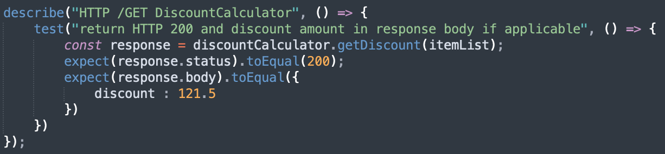
BDD or Behavior Driven Development
BDD
VS
TDD

